Slide 1
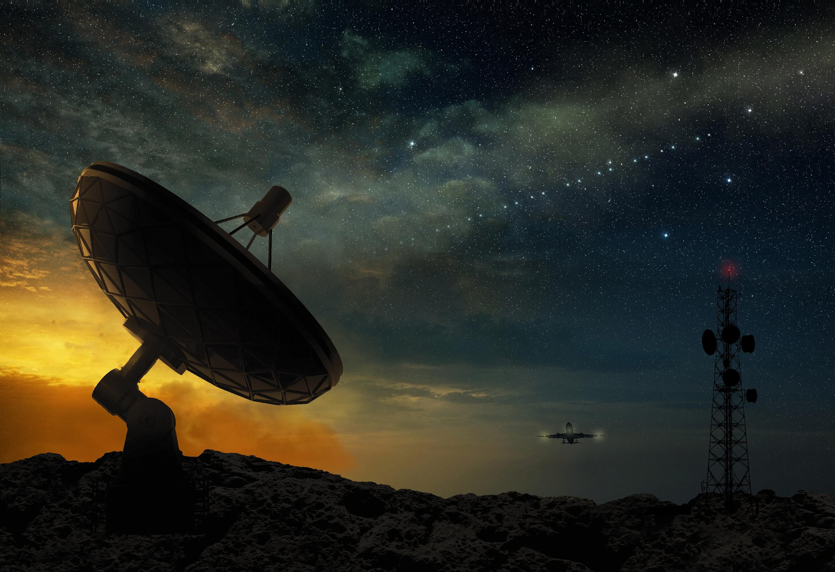

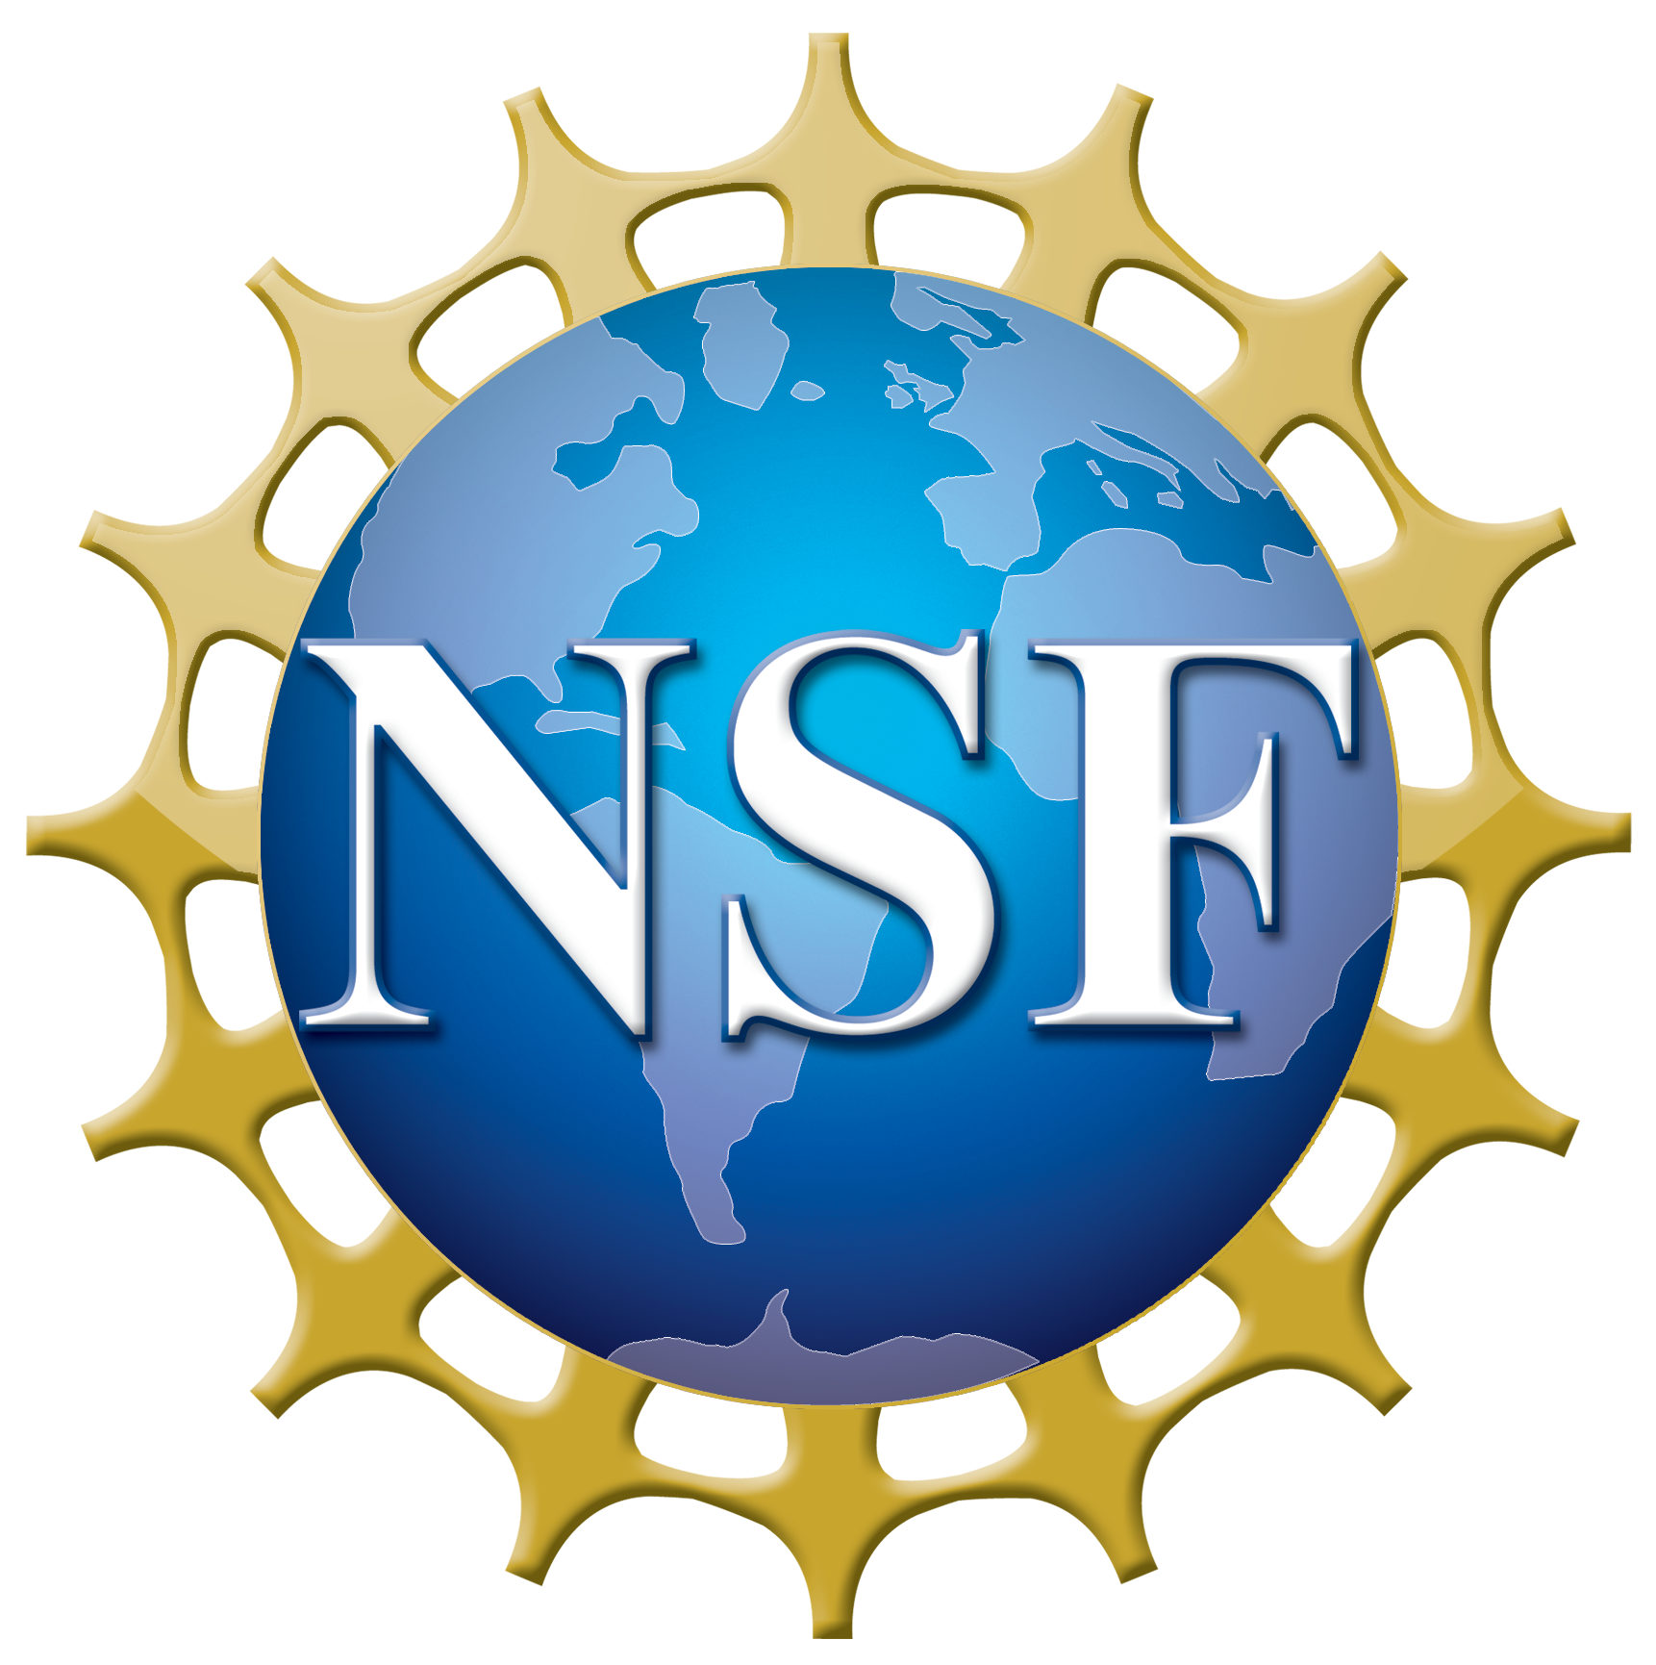
Fixed Satellite Service (FSS) & Radio Astronomy Service (RAS) Coexistence
@ V-band
Charlotte Ramiro and Lilo Heinrich Olin College of Engineering Introduction to Analog and Digital Communications (Fall 2022)

Slide 2
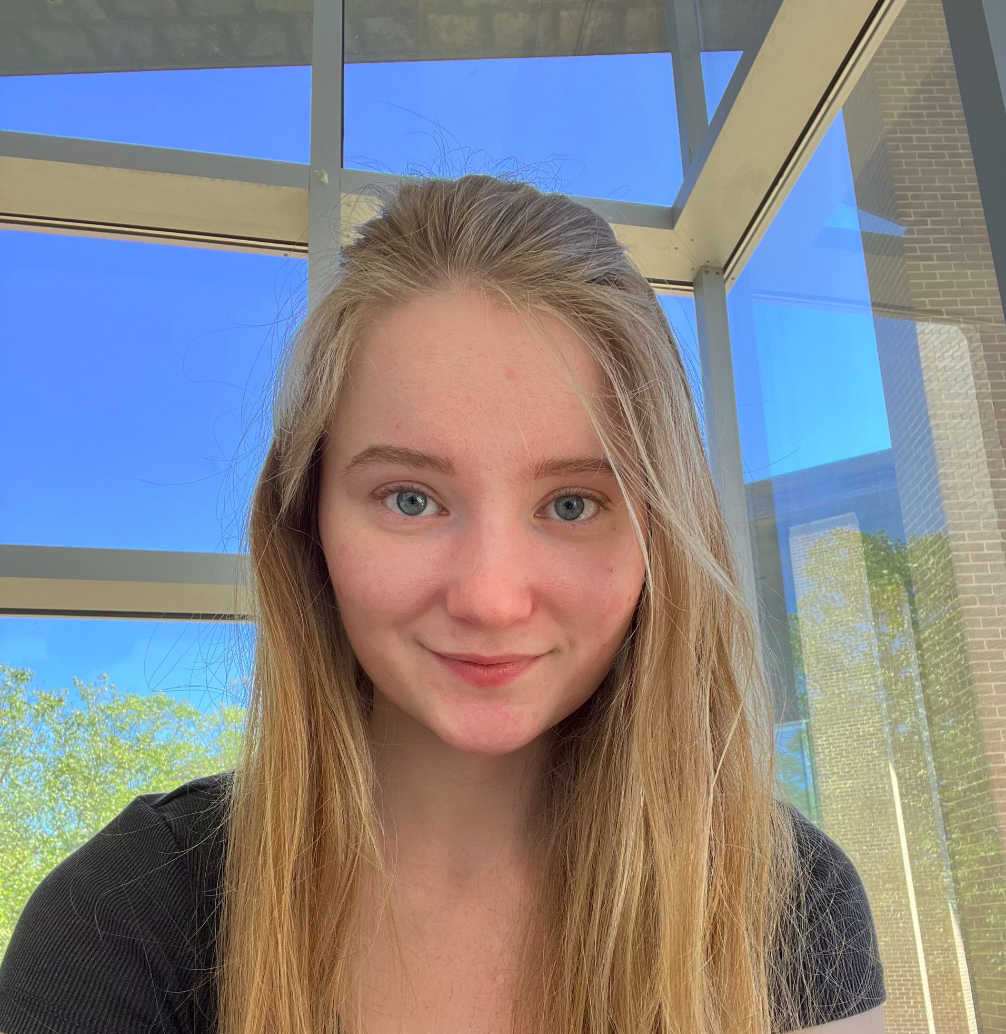
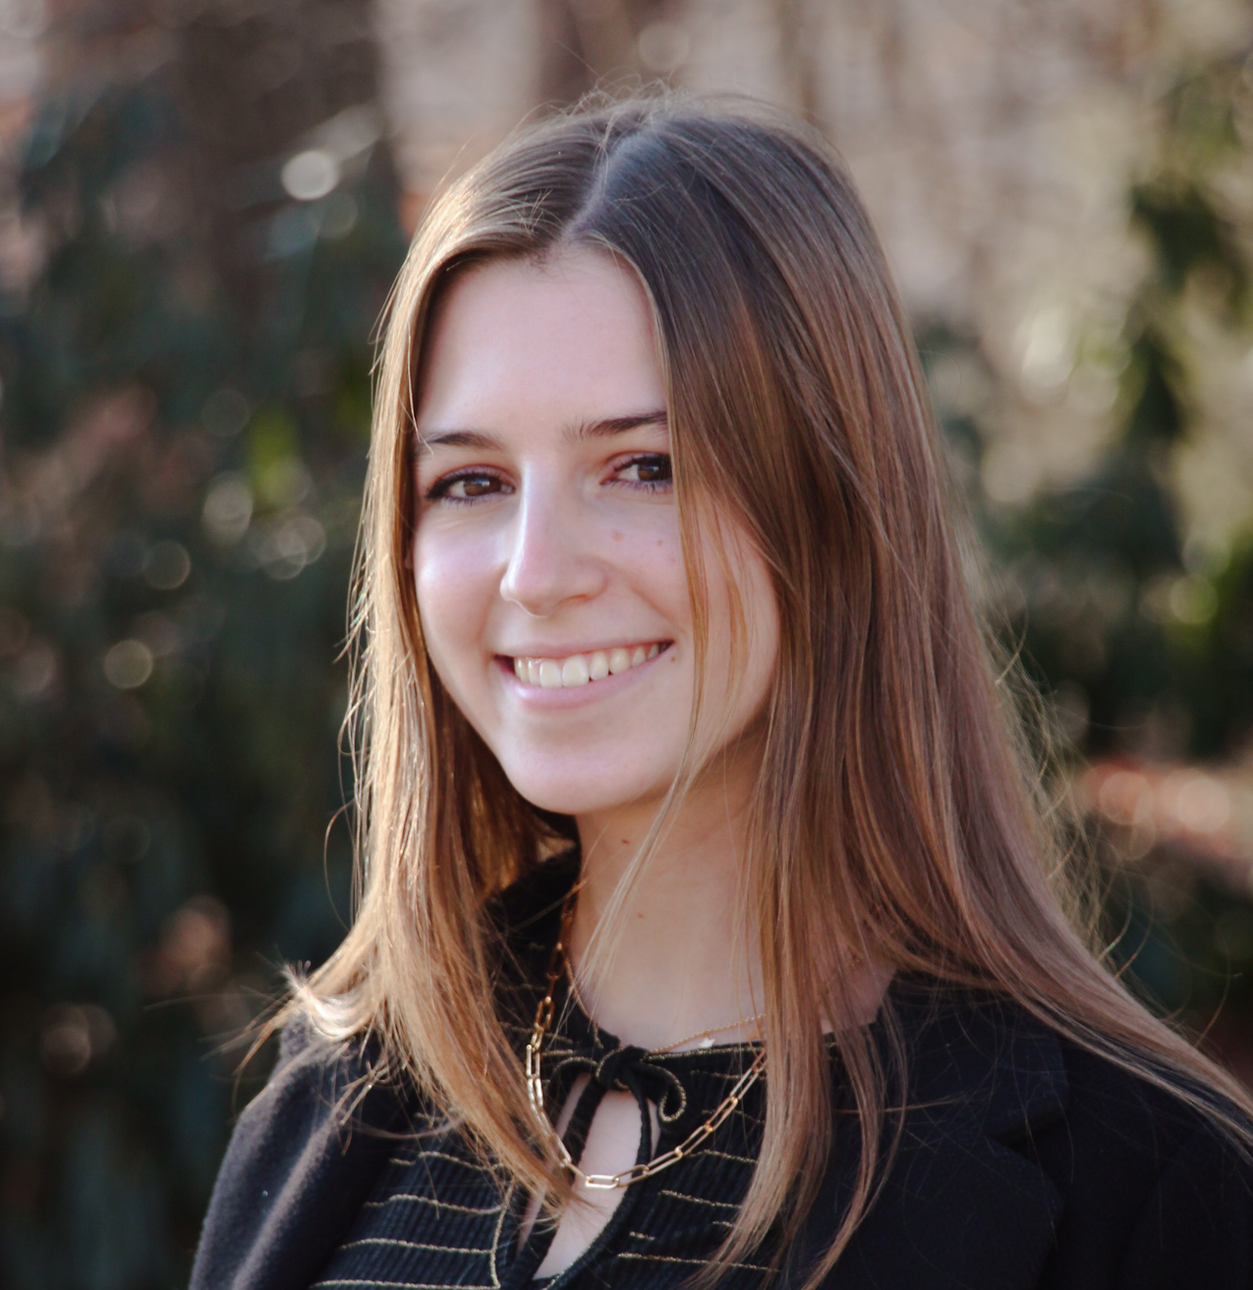
Who we are
Lilo Heinrich
Senior
She/her
Engineering with a focus in Computing
Charlotte Ramiro
Junior
She/her
Electrical & Computer Engineering

Slide 3

Introduction
Incumbent: Radio Astronomy (RAS) operates throughout V-band (40-75 GHz)^{[13]}
Entrant: Fixed Satellite Service (FSS) Broadband Satellites, 37.5-42.5 GHz (Space-to-Earth)^{[14]}
Coexistence Issues: Adjacent and In-band Interference
Radio frequency interference from NGSO FSS constellations poses a threat to Radio Astronomy^{[1][7][8]}

Slide 4
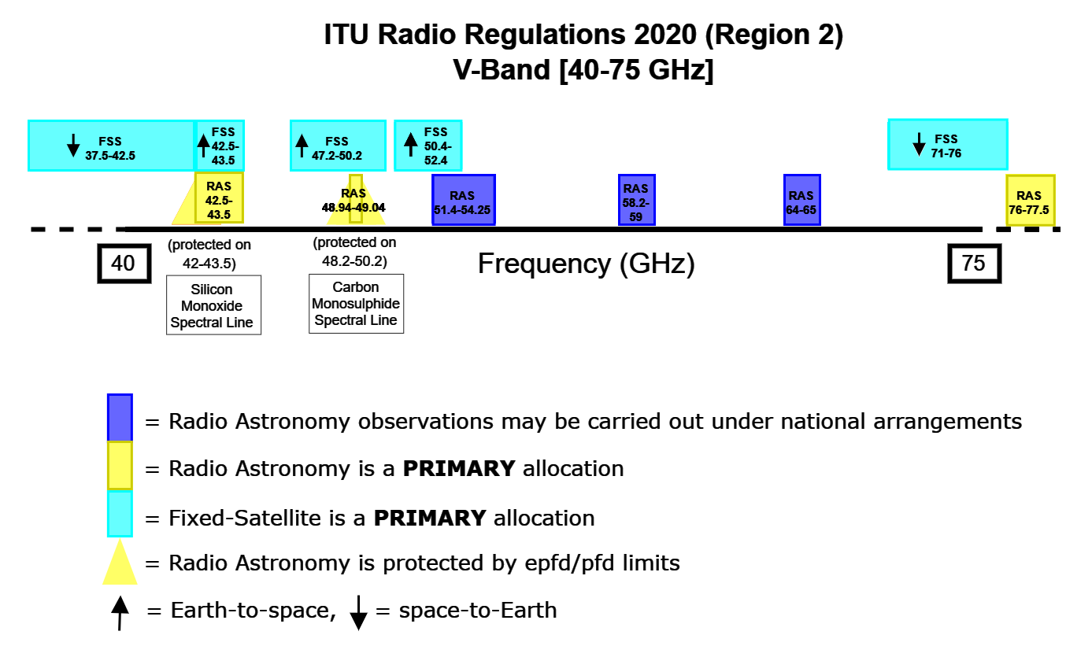

Slide 5
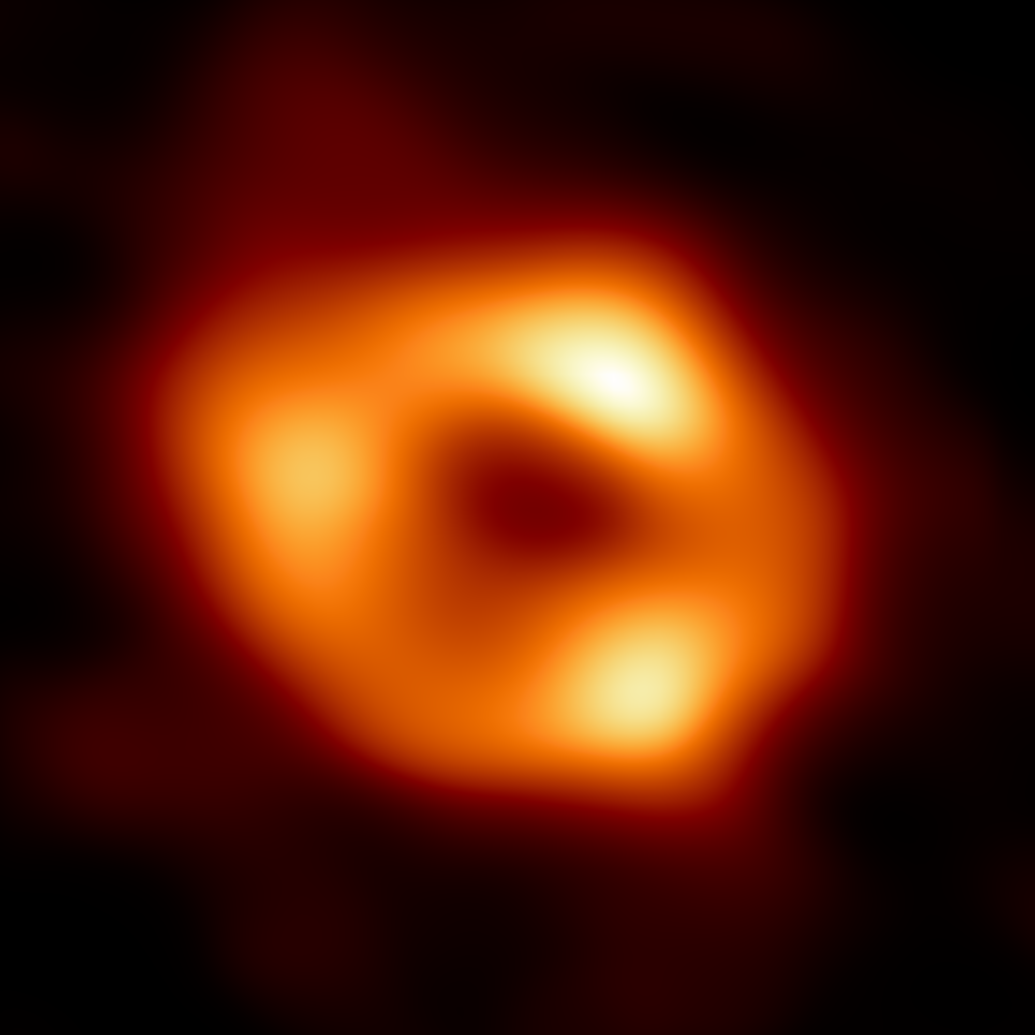
Radio Astronomy (RAS)
Incumbent
Radio telescopes study celestial objects at frequencies outside the visual range^{[4][15]}
Black holes, pulsars, cosmic microwave background^{[3]}
Continuum Emission: Radiation at a wide range of wavelengths (ex. thermal emission)^{[19]}
Spectral Lines: Radiation at specific wavelengths (elements and molecules have spectral lines)^{[19]}
Figure 1: Sagittarius A*, the black hole at the center of our galaxy^{[18]}
Notes:
Radio astronomers use more frequencies than the ones that are designated to them specifically to take their observations
The reason for the interspersed pattern of radio astronomy allocations is that there are very specific frequencies that radio astronomers listen on
Spectral lines are frequencies where there’s an emission or absorption in a narrow frequency range that can be used to identify molecules
Such as silicon monoxide isotopes in 42.5-43.5 GHz
Note: Ground-based radio astronomy is confined to atmospheric windows, wavelength ranges in which the atmosphere is nearly transparent

Slide 6
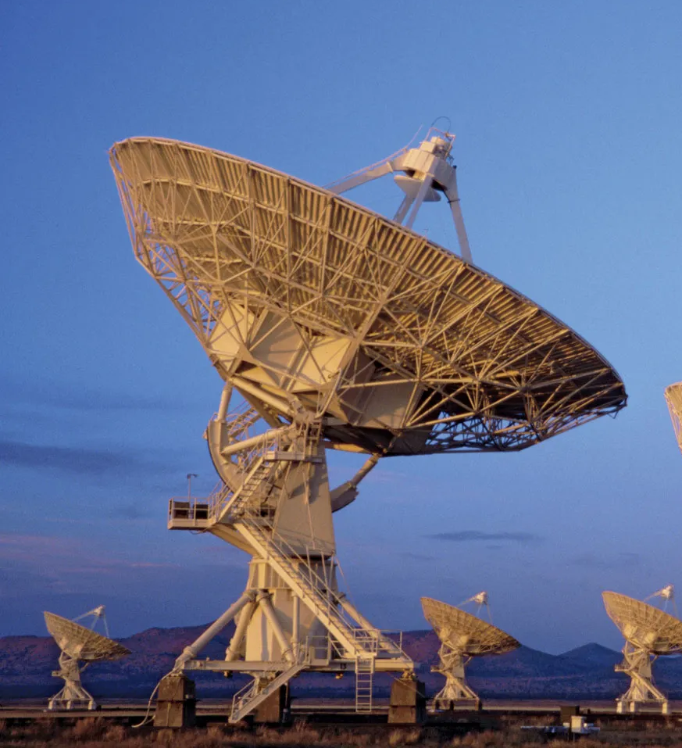
Radio Astronomy (RAS)
Incumbent
Require large antennas and extremely sensitive receiving equipment to pick up very faint and far-away signals^{[1][4]}
Telescope arrays are built in remote high desert areas^{[1][4]}
Radio emissions may cause radio frequency interference (radio quiet zones)^{[1][4]}
Satellites in the path of highly sensitive radio telescopes are dangerous to radio astronomy - cannot escape interference^{[1]}
Figure 2: Very Large Array in New Mexico (NRAO)^{[18]}
Notes:
Radio astronomers do everything they can to avoid interference from things in the ground, but they can’t do as much about things pointed at them from the sky which they’re trying to observe
Radio telescopes require large antennas and extremely sensitive receiving equipment to pick up very faint and far-away signals
Transmitting devices on Earth may cause radio-frequency interference - move to remote places
There are radio telescopes all around the world, many have designated a Radio Quiet Zone surrounding them
Satellites in the path of highly sensitive radio telescopes are dangerous to radio astronomy
Interference can saturate receiver systems and drowns other signals, loses sensitivity
Going blind, not seeing beyond an increasingly crowded atmosphere
Even remote locations aren’t immune from satellites - no place to hide

Slide 7
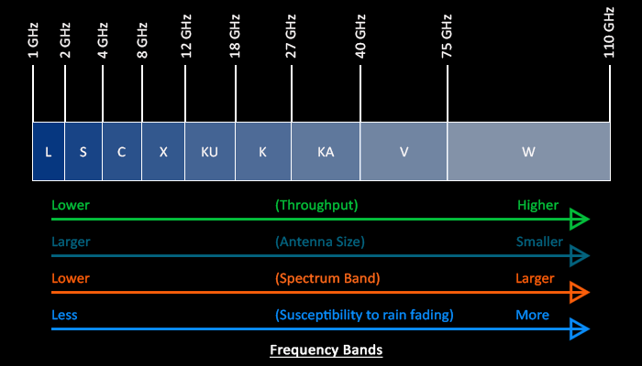
Fixed Satellite Service (FSS) NGSO Constellations
FSS: Radiocommunication service between earth stations at given positions, when one or more satellites are used^{[14]}
Compared to K-band, V-band allows more bandwidth and throughput. However, higher frequencies are more susceptible to fade^{[10]}
“The history of wireless communications has been a slow migration to higher frequencies over time” - Armand Musey, Summit Ridge Group^{[12]}
Figure 3: Comparison of V-band and other frequency bands
Notes:
Need better antennas, more powerful satellites, improved processing algorithms to overcome the technical challenges
That’s why we are seeing the migration from K band up to V band

Slide 8
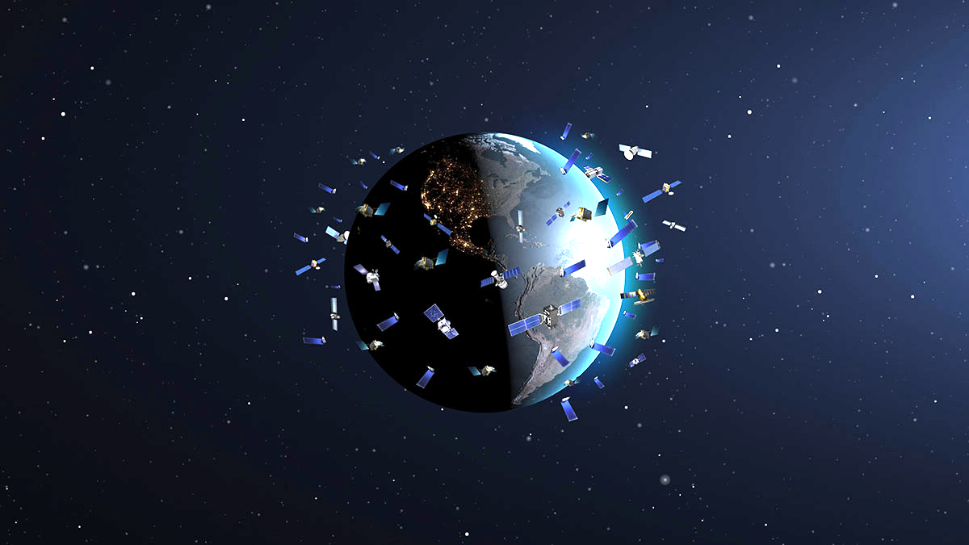
Fixed Satellite Service (FSS)
NGSO Constellations
Over 4,000 NGSO FSS satellites launched since 2019, operating primarily in K-band
By November 2021: Non-geostationary satellite constellations seek FCC approval for nearly 38,000 V-band satellites for new or expanded broadband networks^{[12]}
V-band Players: Amazon, Astra, Boeing, Inmarsat, Intelsat, Hughes, OneWeb, SpinLaunch, Telesat, SpaceX^{[12]}
Figure 4: Constellations in orbit (concept art)^{[11]}
Notes:
38,000 satellites may be an overestimate, applicants may be creating a stake in the ground with the FCC since they can only reduce but not increase constellation size.

Slide 9
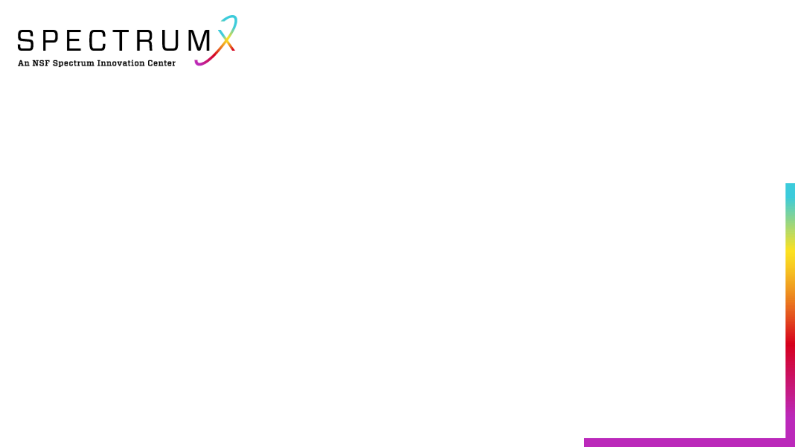
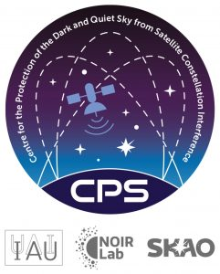
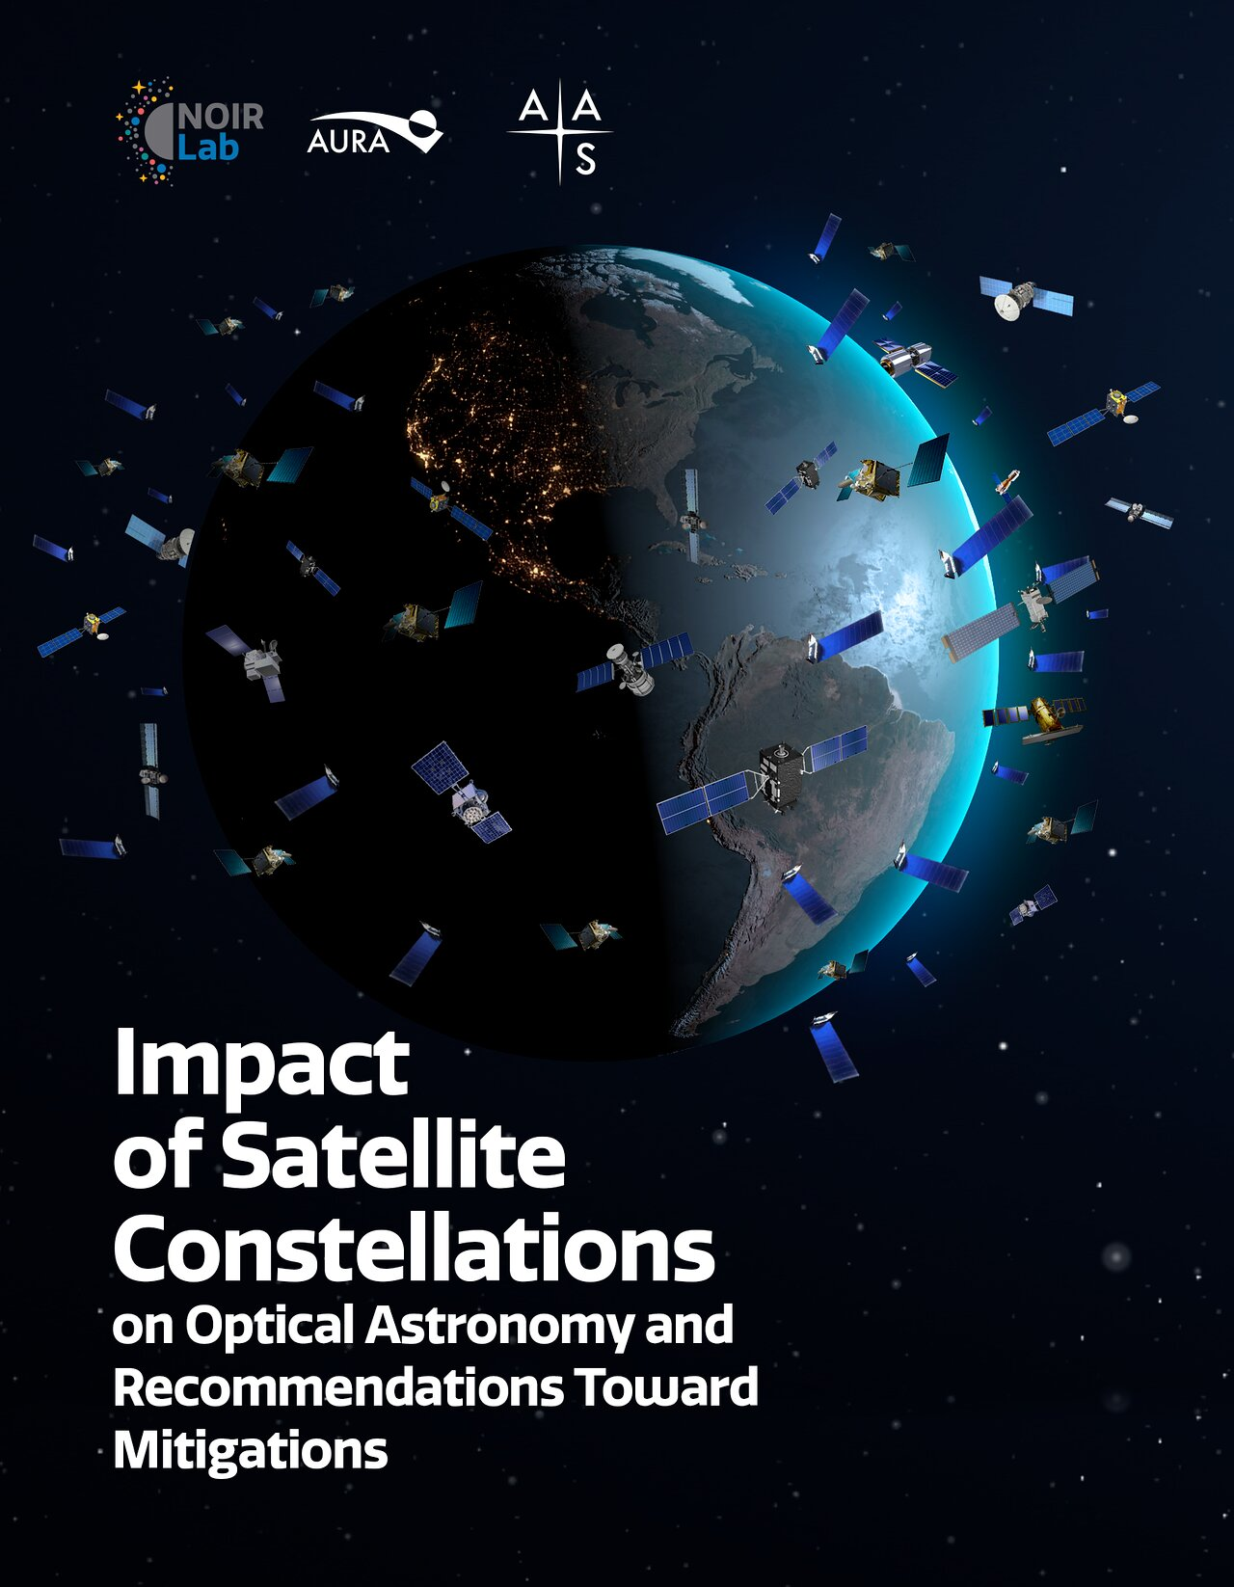
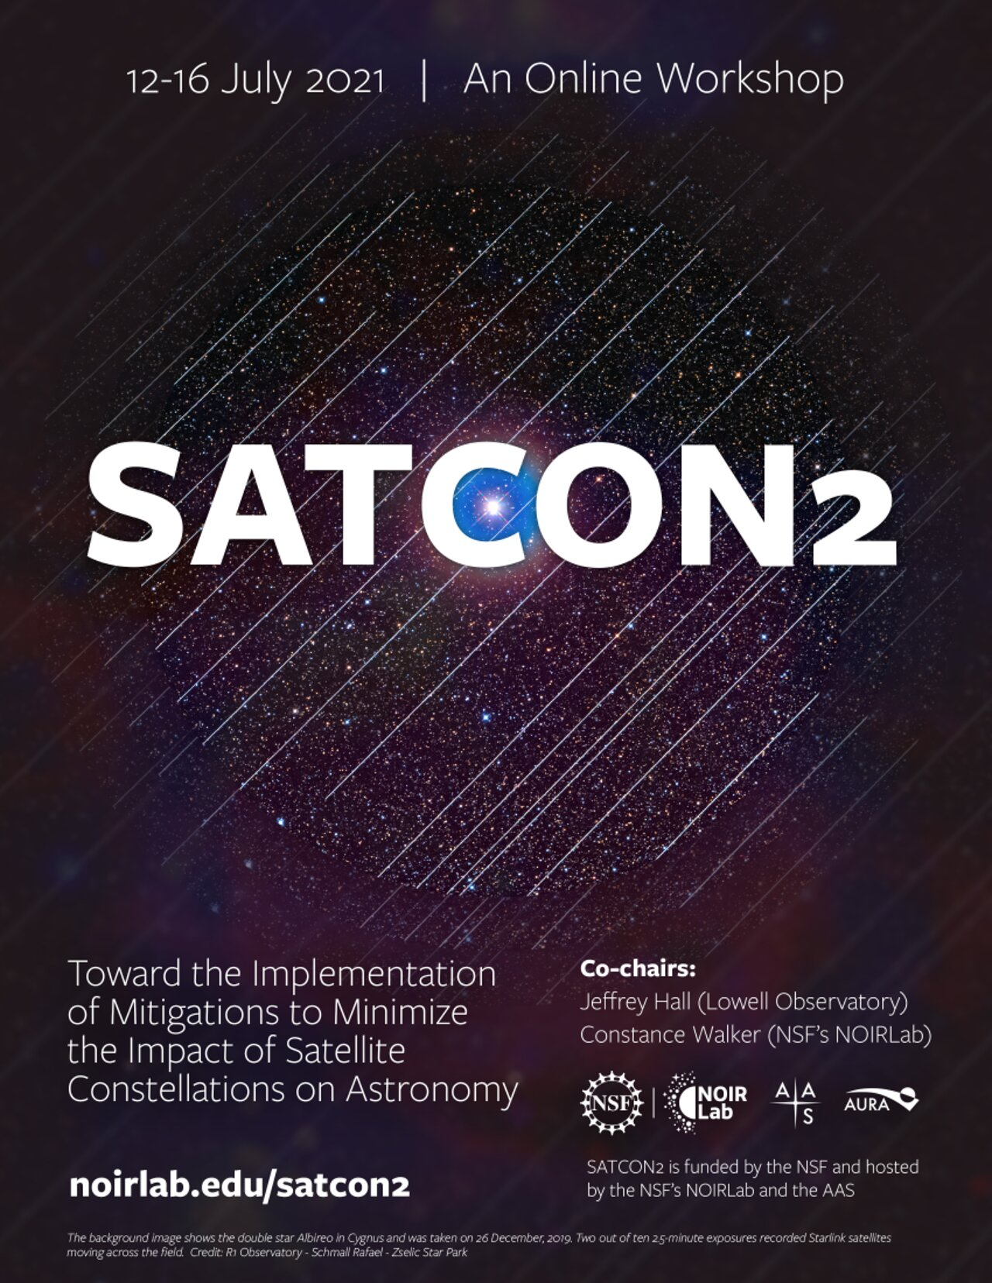
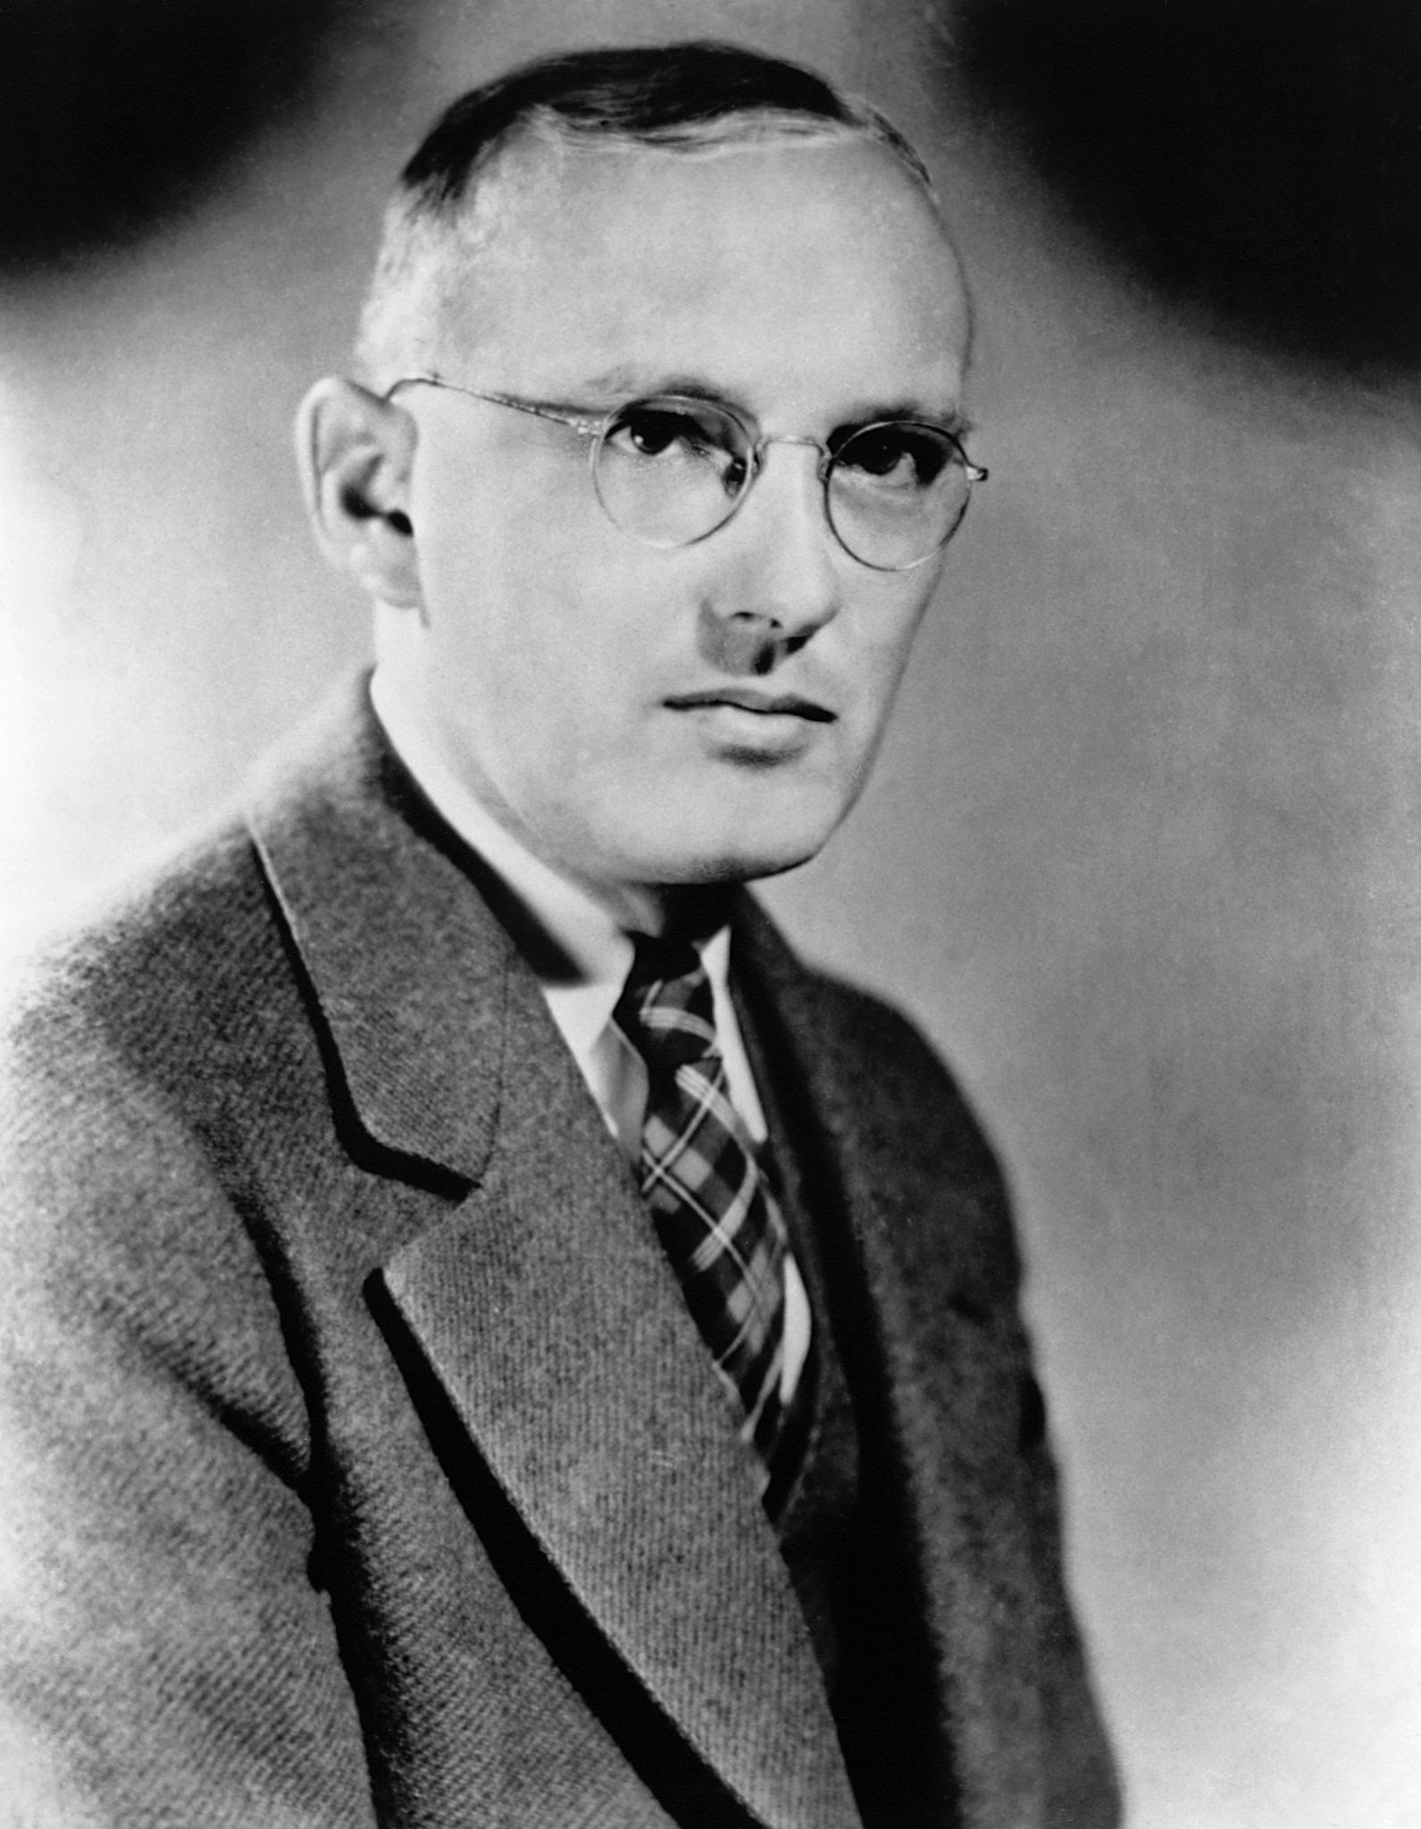
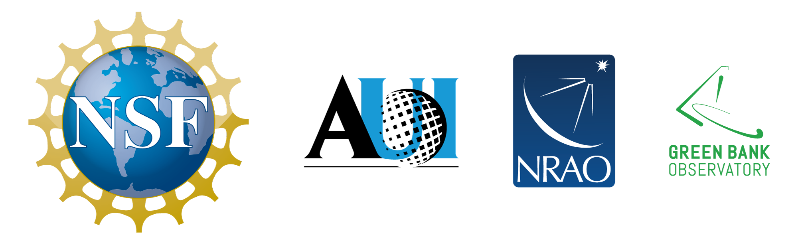


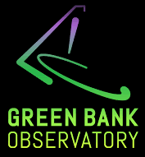
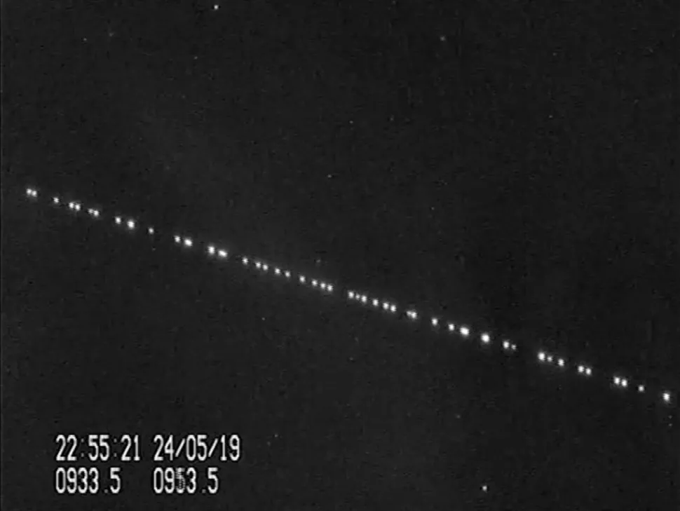
National Radio Quiet Zone established
1957
SATCON1^{[9]}
June 2020
SATCON2^{[5][11]}
July 2021
Centre for the Protection of the Dark and Quiet Sky^{[7]}
April 2022
Karl Jansky
1932
1980
Very Large Array built
May 2019
SpaceX Starlink first launch^{[6]}
November 2021: FCC filings for nearly 38,000 V-band satellites^{[12]}
Notes:
Centre for the Protection of the Dark and Quiet Sky from Satellite Constellation Interference (CPS)

Slide 10
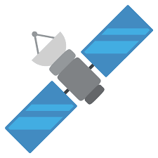
Interference Geometry
SpaceX V-band NGSO Satellite System
FSS SAT
Entrant
P_{TX,FSS}
G_{TX,FSS}
EIRP = P_{Tx, FSS}+ G_{Tx, FSS}
SpaceX V-band Satellite:
Altitude: ~336-1110 km^{[17]}
Interfering signal:
Downlink on 37.5-42.5 GHz^{[17]}
L_{FSPL}
P_{Rx, RAS}= P_{Tx, FSS}+ G_{Tx, FSS}+ G_{Rx, RAS}- L_{FSPL}
RAS ES
Incumbent
P_{RX,RAS}
G_{RX,RAS}
FSS ES
Entrant
P_{RX,RSS}
G_{RX,FSS}

Slide 11
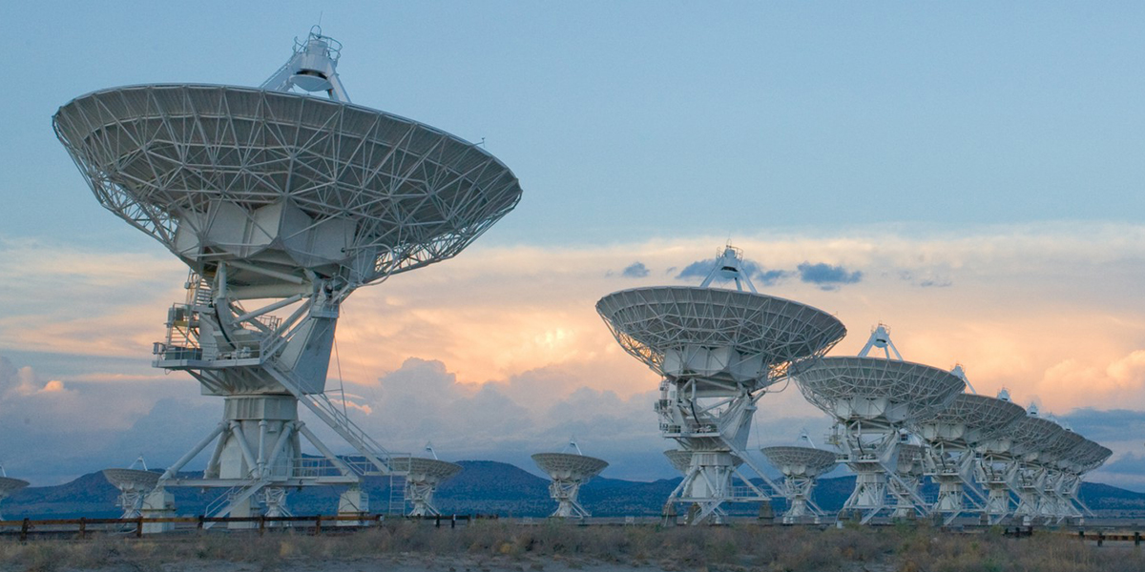
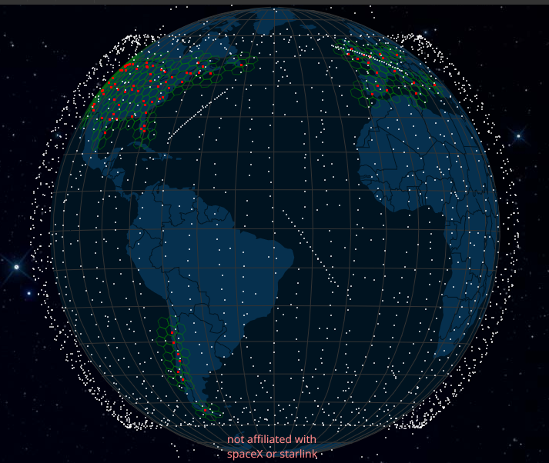
Proposed Mitigations
SatHub: software tools for astronomers to avoid satellite passes in observations or correct affected observations^{[5][9][11]}
Share more accurate satellite position data to enable astronomers to avoid satellites in observations (SpaceX)^{[5][9][11]}
Less effective the more satellites there are^{[20]}
Arrayed telescopes less vulnerable to RFI than single beam^{[1]}
Radio filters on satellites to protect RAS (OneWeb)^{[2]}
Notes:
There are many proposed mitigations, but these are not solutions
SatHub and SpaceX
Laser communication still being developed, doesn’t solve the problem because satellites still have to transmit down to earth

Slide 12
Proposed Solutions
Coordination: NRAO and SpaceX continue to collaborate on experiments to study interference from FSS to RAS^{[20]}
Steer satellite transmitters away from telescope sites^{[20][16]}
Finding success using phase delay^{[20]}
Center for Protection of the Dark and Quiet Sky (CPS)^{[7]}
Policy: Find ways to inform FSS about RAS operations to allow them to adjust operations to avoid those downlink channels - NRAO Dr. Chris De Pree^{[20][1]}
Regulate limits on radio frequency interference (RFI)^{[1]}
EPFD and Interference-to-Noise (I/N) recommendations^{[14]}
Notes:
CPS brings together stakeholders of the issue to work on solutions to coexistence and have already had success in optical astronomy. Their continuing work in radio astronomy will be important.
Our team talked with Dr. Du Pree at the NRAO and learned about another potential solution which is to find ways to inform FSS about Radio astronomy operations so that FSS can input that information into the beam planning algorithm and steer around the telescope sites and replan beams or to turn off the use of those downlink channels briefly. This has potential to be a solution to FSS and RAS coexistence, not just a mitigation.
We think these are some of the more promising routes for resolution:
Beam steering
Steer satellite transmitter beams away from telescope sites
NRAO and SpaceX are coordinating on beam steering tests to determine interference by angle and test phase delay
Meanwhile satellites could stop transmitting in the affected channels while passing over (this would cost operators money and reduce coverage reliability)
SKAO: requiring operators to steer their satellites’ beams away from the telescope dishes is a simple software modification which could reduce the impact on SKA by a factor of 10
Center for protection of dark and quiet skies
Working relationship with the stakeholders and ability to facilitate coordination efforts
Work with companies directly, regulation is lengthy
Influence hardware design, effect operating changes
It seems that this continued coordination between FSS and RAS is the key to finding solutions to allow Radio Astronomers to continue their work.
Regulating limits on RFI is another route which may be lengthier but afford more absolute protections rather than relying on the goodwill of NGSO operators. Two metrics which may be used are EPFD and I/N.

Slide 13
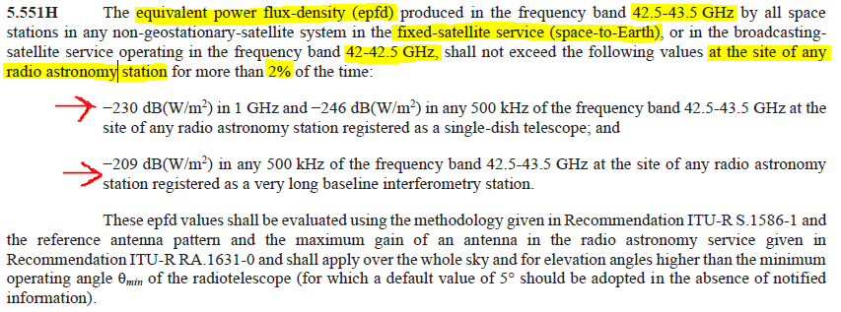
Recommendation on Equivalent Power
Flux Density (EPFD) in 42.5-43.5 GHz
ITU Radio Regulations Chapter II Article 5^{[14]}
EPFD is basically the power of the interferer’s (FSS satellites) transmissions that are received by the victim (radio telescopes)
Notes:
Here is the ITU recommendation for protecting RAS in V-band using EPFD.
This is just a recommendation, and it has been broken before by GLONASS and Iridium. The ITU is treaty-level, so recommendations carry weight but are not hard rules.
EPFD is basically the power of satellites’ transmissions that are received by radio telescopes
Could make it more specific to constellations and could regulate it instead of recommend - requirement to submit evidence showing that the constellation complies
For example, SpaceX’s plan did not show they could meet the I/N recommendation on high-inclination polar coverage orbital planes (but that was not for RAS).

Slide 14
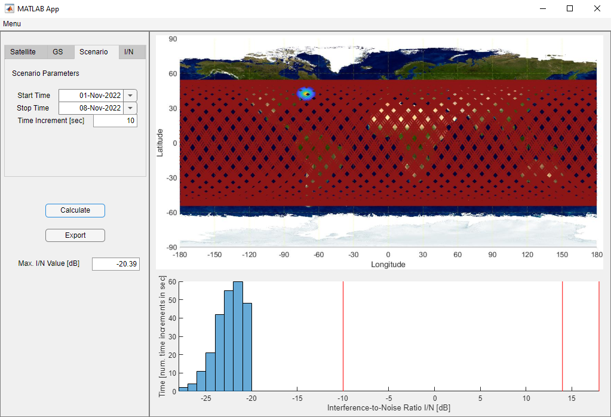
Interference-to-Noise (I/N)
Another metric of RFI
Quantify Interference using Dynamic Interference-to- Noise Analysis
OSSTP currently working on a tool for this
First step to mitigating inter- ference is understanding it
Notes:
Another metric of RFI is I/N

Slide 15
In Conclusion
Inform satellites about RAS operations and adjust operations to avoid those downlink channels
Require operators to steer satellite beams away from telescope sites and consider the use of additional RF filters on their satellite systems
Further work on RFI Limits and mathematical modeling of EPFD and I/N

Slide 16
Questions?

Slide 17
References
[1] Kimbrough, A. (2019, April 29). “Satellite Constellations and radio astronomy.” The Space Review. thespacereview.com/article/3702/1.
[2] Henry, C. (2019, August 27). “Radio astronomers worried about oneweb interference.” SpaceNews.
spacenews.com/radio-astronomers-worried-about-oneweb-interference.
[3] Levesque, E. (2021, April 13). “How radio astronomy reveals the universe.” Quanta Magazine.
quantamagazine.org/how-radio-astronomy-reveals-the-universe-20210413.
[4] “An Introduction to Radio Astronomy,” National Radio Astronomy Observatory. (2018, October 25). cv.nrao.edu/~sransom/web/Ch1.html.
[5] Foust, J. (2021, July 27). “Astronomers back technical efforts to reduce impacts of satellite megaconstellations while seeking regulatory solutions.” SpaceNews.
spacenews.com/astronomers-back-technical-efforts-to-reduce-impacts-of-satellite-megaconstellations-while-seeking-regulatory-solutions.
[6] Foust, J. (2019, June 3). “Little legal recourse for astronomers concerned about Starlink.” SpaceNews.
spacenews.com/little-legal-recourse-for-astronomers-concerned-about-starlink.
[7] Foust, J. (2022, February 5). “New center to coordinate work to mitigate effect of satellite constellations on astronomy.” SpaceNews.
spacenews.com/new-center-to-coordinate-work-to-mitigate-effect-of-satellite-constellations-on-astronomy.
[8] Foust, J. (2021, July 3). “Radio Telescope Faces ‘extremely concerning’ threat from satellite constellations.” SpaceNews.
spacenews.com/radio-telescope-faces-extremely-concerning-threat-from-satellite-constellations.
[9] Foust, J. (2022, August 26). “Report outlines measures to reduce impact of satellite constellations on astronomy.” SpaceNews.
spacenews.com/report-outlines-measures-to-reduce-impact-of-satellite-constellations-on-on-astronomy.
[10] Rainbow, J. (2022, June 15). “Connecting the dots: Addressing the V-band Disconnect.” SpaceNews.
spacenews.com/connecting-the-dots-addressing-the-v-band-disconnect.
[11] Hall, J., Walker, C., et al. (2021, October 15). “Executive Summary of the SATCON2 Workshop.” National Optical-Infrared Astronomy Research Laboratory.
noirlab.edu/public/media/archives/techdocs/pdf/techdoc031.pdf.
[12] Sheetz, M. (2021, November 5). “In race to provide internet from space, companies ask FCC for about 38,000 new broadband satellites.” CNBC.
cnbc.com/2021/11/05/space-companies-ask-fcc-to-approve-38000-broadband-satellites.html.
[13] “Preferred frequency bands for radio astronomical measurements.” International Telecommunications Union. itu.int/rec/R-REC-RA.314-10-200306-I/en.
[14] “Radio Regulations.” International Telecommunications Union. (2020). itu.int/pub/R-REG-RR-2020.
[15] “The Science of Radio Astronomy.” National Radio Astronomy Observatory. (2020, October 15). public.nrao.edu/radio-astronomy/the-science-of-radio-astronomy.
[16] “SKAO needs corrective measures from satellite 'mega-constellation' operators to minimise impact on its telescopes.” Square Kilometer Array Observatory.
(2020, October 7). skatelescope.org/news/skao-satellite-impact-analysis.
[17] “SpaceX V-band Non-Geostationary Satellite System Attachment A Technical Information.” Federal Communications Commision. (2017, March 1).
fcc.report/IBFS/SAT-LOA-20170301-00027/1190019.
[18] “Image Gallery.” National Radio Astronomy Observatory. public.nrao.edu/gallery.
[19] Hallenbeck, G. (2016). “Introduction to Radio Astronomy.” Arecibo Legacy Fast ALFA Survey.
egg.astro.cornell.edu/alfalfa/ugradteam/uat16talks/uat16_introRadAstro.pdf.
[20] Fleming, K., Omer, A., & De Pree, C. (2022, November 7). Interview with Chris De Pree. Personal.

